Slide 1
Motor - Useful Docs on quote page test
Test Brief

Slide 2
Test Hypothesis
We know that many users complain about there being too much text on our site and that our text is hard to read. The recent IPID release introduced a new “Is this cover right for you?” section onto the quote page that was not well written or designed. We believe this is likely to have caused additional confusion. So, by changing the heading and re-writing the text we will make this section much more useful for the customer, reduce confusion and potentially improve the flow through to the next step of the journey.

Slide 3
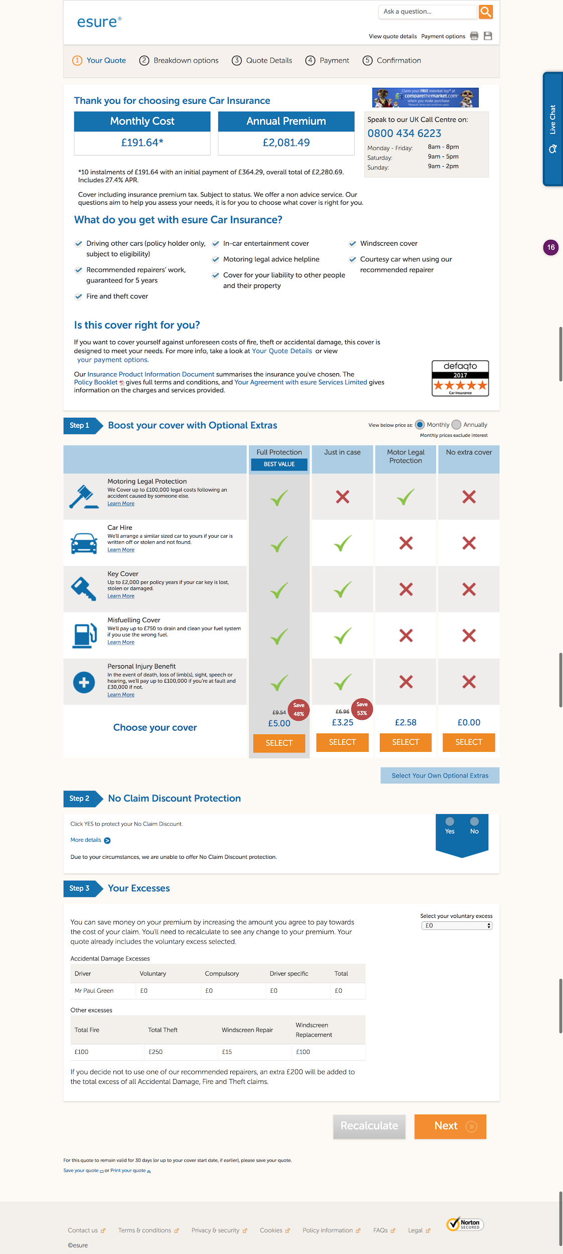
Current Design
All this will be reworded and displayed differently.
The ‘Your Quote Details’ link will be removed too.
(See final wording and layout on next slide)

Slide 4
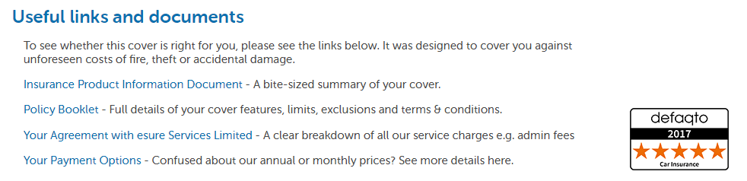
New Design
All links are present in the original, they are all just re-ordered and displayed in a list view instead. NOTE: All links must open in a new tab.
Test will run on all devices on ES Motor. I’d also like to run this on SW Motor (can we re-use the same code for SW?) as all the content and changes are the same.
Main KPI: Flow through to the next step in the journey

Slide 5
Tracking Requirements
We need to track the number of clicks on each text link. Each click will trigger an individual click goal for each link and also an overall “Text Link Clicked” click goal so we can compare overall clicks between the original and the variation
In summary, there will be 5 individual click goals on the original, and 4 on the variation. I’m happy for you to use the anchor text as the Goal Name

